Slide 1
Module 8: Child and adolescent TB and the NTP

Slide 2
Learning Objectives
Recognise the role of NTP in management of child and adolescent TB .
Identify health programmes and other sectors that are critical in the programmatic management of child and adolescent TB.
Recognise opportunities for integration.
Notes:
In this final module, you will learn about the role of the NTP in provision of child and adolescent TB services. You will also learn about the role of other health programmes in supporting these services and how integrating child TB care with those programmes can improve care delivery at your health facility.

Slide 3
Outline
Introduction
The structure of the NTP
The role of the NTP
The Multisectoral Accountability Framework
Conclusion
Notes:
In this module, we will look at the role of the NTP in the provision of TB services. You will also learn about the multisectoral accountability framework and how this framework can help increase the reach of TB services. You will also learn about the other health services in which child TB services can be integrated and how integration can improve outcomes for both child TB and other disease. Finally, you will learn about how to maintain child TB services during emergencies or natural disasters like the recent COVID-19 pandemic.

Slide 4
Outline
Introduction
The structure of the NTP
The role of the NTP
The Multisectoral Accountability Framework
Conclusion
Discussion
Notes:
We will pause and have a short discussion before we get into the topic.

Slide 5
Discussion on setting-specific practices

Slide 6
Discussion: Role of NTP in Child and Adolescent TB
What is the role of the NTP in the management of child and adolescent TB in your setting ?
1
What health programmes or strategies are linked to child and adolescent TB in your setting?
2
Are child and adolescent TB activities regularly assessed and supervised? If yes, how is this supportive supervision organised in your country?
3

Slide 7
What is the role of the NTP in the management of child and adolescent TB in your setting ?
1
What health programmes or strategies are linked to child and adolescent TB in your setting?
2
Are child and adolescent TB activities regularly assessed and supervised? If yes, how is this supportive supervision organised in your country?
3

Slide 8
Introduction

Slide 9
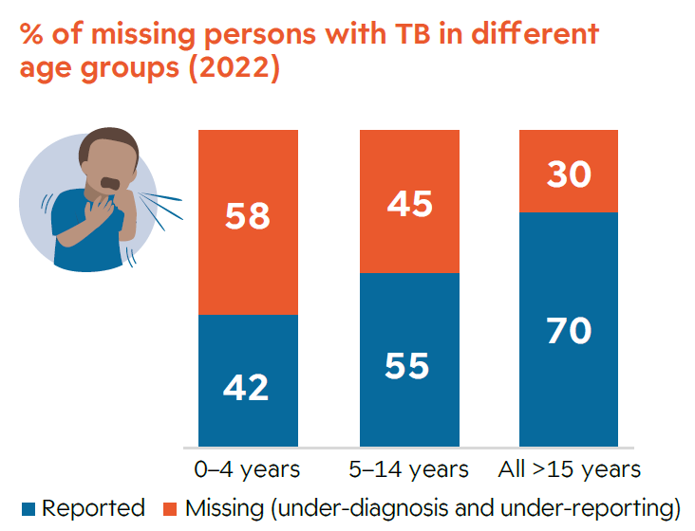
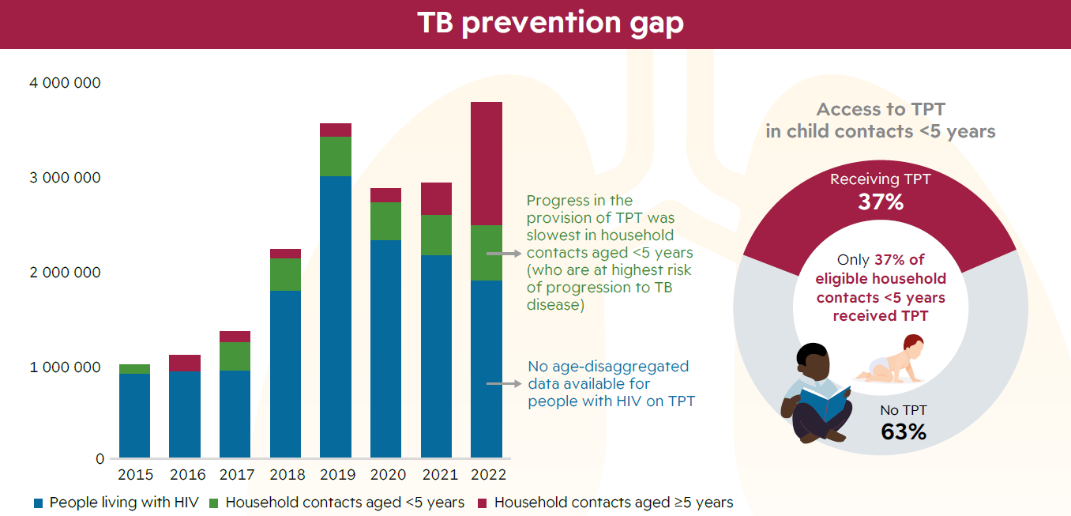
Introduction
The treatment coverage gap remains highest among the youngest children.
*UNHLM - UN High-Level Meeting (HLM
Notes:
Countries are at different stages of updating and implementing their strategic plans for TB. The updated Roadmap and commitments made at the United Nations High Level Meeting held last year highlight the need to address child and adolescent TB ​in order to end TB.
National TB Programmes (NTPs) are departments in the Ministries of Health which are responsible for formulating national policies, guidelines and strategic plans to ensure that global targets for TB control are met. NTPs also coordinate relevant stakeholders to ensure that TB care and prevention services are implemented equitably across the country.

Slide 10
NTP structure

Slide 11
Structure of the NTP:
ADULT & CHILD
ADAPT TO LOCAL SETTING
District Level
Facility Level
Regional/Provincial Level
National
Level
Regional/ Provincial Level
Notes:
Similar to other health services, TB services in most countries are structured in four levels
The health facility-level which is responsible for the identification and evaluation of persons with presumptive tuberculosis and treatment of those diagnosed with TB
The district-level : under the stewardship of District TB coordinators. These form the basic reporting units of the TB programme. The District TB coordinators provide onsite mentorship in TB treatment, reporting and recording to the health facilities.
Intermediate (provincial, regional or county) level: provides support to facilities and the district level.
National level: At the national level, the NTP contains core staff who are responsible for coordinating the overall management of the tuberculosis service

Slide 12
Structure of NTP at the national level
ADULT & CHILD
Director
Deputy director
DR-TB Officer
Child TB Officer
M&E Officer
TB & Comorbidities Officer
TB Prevention Officer
Lab Services Officer
ADAPT TO LOCAL SETTING
Notes:
At the national level, the NTP needs to be staffed by a full-time director and a team of well-trained officers to carry out several functions. Often, each officer has an area of focus which they are responsible for e.g., drug-resistant TB, child and adolescent TB, co-morbidities, TB prevention, training and capacity building or TB laboratory services. These officers oversee all country activities related to their area of focus and are responsible for updating the director and deputy director about the activities within that area.
The NTP should work closely with the other departments within the Ministry of Health to ensure that it offers comprehensive care services to patients with TB. Departments that are crucial to work with include: primary health care/community health, non-communicable diseases, other communicable diseases e.g., HIV and malaria.

Slide 13
NTP roles at national level

Slide 14
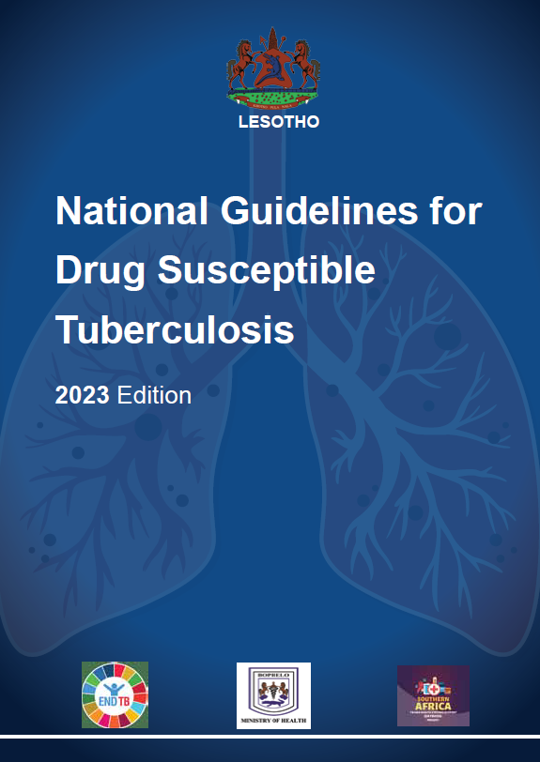
Leadership and governance
Formation of a
multi-disciplinary
Child and adolescent TB
working group within the NTP.
Notes:
One of the major roles of the NTP is to provide national and sub-national strategic direction for child and adolescent TB.
This includes activities like:
Development of national guidance on child and adolescent TB which may be separate and/or integrated within other guidelines
The identification of a child and adolescent TB focal point at national level to coordinate stakeholders working to improve delivery of child TB care services within the country.
Formation of a multi-disciplinary child and adolescent TB working group within the NTP
Promotion of collaborative TB-HIV services and integration of TB care into relevant health services e.g., maternal, child and adolescent health services , youth friendly services and school health.

Slide 15
Service delivery
Coordination of capacity building.
May include training, mentorship, coaching, supportive supervision.
Access to quality medicines, including child friendly formulations (dispersible formulations).
Integration with other health programmes.
Increased funding for child TB services.
MATERNAL
TB
CHILD
&
ADOL.
HIV
Notes:
The NTP should also ensure availability and access to quality child and adolescent TB services at national level through
Coordination of capacity building efforts for healthcare workers in child and adolescent TB focused areas. Capacity building may include training, mentorship, coaching, support supervision.
Ensure access to quality medicines for treatment and prevention including child friendly formulations for children (dispersible formulations) for both TB treatment and prevention)
Encouraging integration of other health programmes e.g., maternal, child and adolescent care delivery services
Advocacy for increased funding for child TB services.

Slide 16
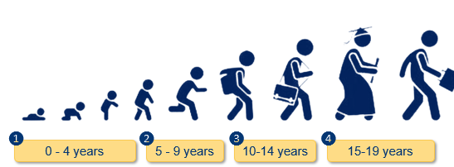
Monitoring of services
TB recording and reporting tools.
Record and report age-disaggregated data on programmatic indicators for diagnosis, treatment outcomes and contact management.
Robust electronic health information systems.
Notes:
The NTP is responsible for monitoring the delivery of child and adolescent TB services at the national level.
This involves
TB recording and reporting tools that cater for the needs of children and adolescents are developed and scaled up at all levels of the healthcare system. This includes tools that collect age-disaggregated data on TB diagnosis and treatment including TB preventive therapy.
Evaluation of age-disaggregated surveillance data to target settings or populations for implementation and assessment of specific activities
Robust electronic health information systems such as electronic case-based systems are adapted and scaled up across the country

Slide 17
Financing
Mobilisation and advocacy for funding of child and adolescent TB services at the national and international levels.
Develop adequate budgets for child and adolescent TB interventions.
Use tools, such as the ‘OneHealth Tool’ and Paediatric TB Budgeting tool.
These tools help facilitate the costing of key interventions for child and adolescent TB, e.g., specimen collection, contact investigation, TB preventive treatment and training.
Software tool designed to inform national strategic health planning in low- and middle-income countries.
Notes:
The NTP is responsible for mobilisation of domestic funding and advocacy for funding of child TB services internationally.
To carry out these functions, NTPs should develop adequate budgets for child and adolescent TB interventions at all levels of services. Tools such as the One Health Tool and Pediatric TB budgeting tool can be used. These tools help facilitate the costing of key interventions for child and adolescent TB e.g., specimen collection, contact investigation, TB preventive therapy and training.

Slide 18
Operational research
Continuous evaluation and improvement of services.
Notes:
NTPs should continuously evaluate the processes and results of implementation to understand “what”, “why”, and “how” interventions work or do not work in their setting. NTPs in consultation with stakeholders, e.g., community members, researchers and civil society should then formulate potential solutions to interventions that do not work or those that work sub-optimally and pilot test these solutions prior to scaling them across the country.

Slide 19
NTP roles at sub-national level

Slide 20
Key functions of regional/provincial TB coordinator
Coordinate management of TB services, including support supervision of district TB coordinators.
Coordinate with other department and organisations to ensure equitable provision of TB services in the region.
Management of TB laboratory and pharmaceutical services.
Participate in TB surveys and campaigns and programme reviews.
Notes:
Provincial TB coordinators are frequently medical officers with public health qualifications.
Their duties include
a) coordination with various organisations e.g., private organisations and donor organizations (implementing partners) to ensure equitable provision of child and adolescent TB services within the region,
b) coordination of child and adolescent TB services across several districts in their region including supportive supervision and mentorship of district TB coordinators.
c) coordination with laboratory and pharmaceutical divisions at the Ministry of Health to ensure that health facilities within their region have adequate supplies of TB lab and pharmaceutical supplies e.g., paediatric formulations of TB medicines
Regional TB supervisors will also oversee recording and reporting and active use of TB data in their region and participate in TB campaigns, surveys and reviews taking place in the districts in their region or province.

Slide 21
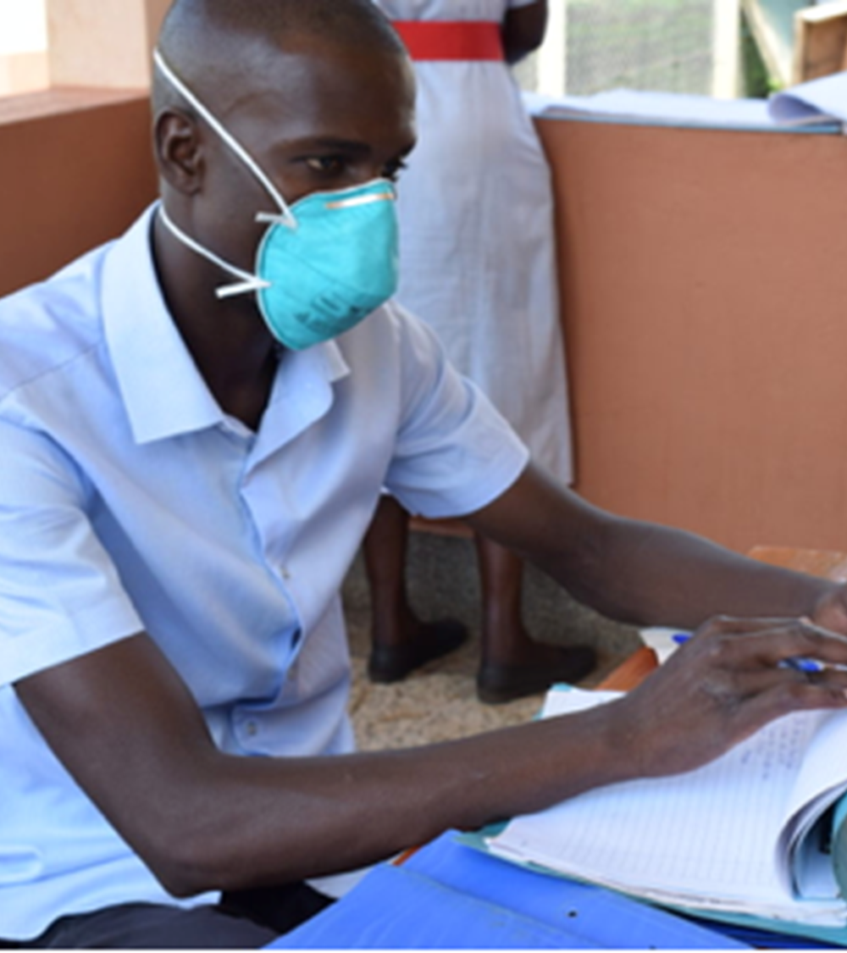
Key functions of district TB coordinator
Manage TB services.
Oversee recording, reporting and coordinate TB data use in facilities.
Carry out support supervision of TB services.
Coordinate with other services, such as laboratory, supply chain, HIV/AIDS and maternal and child health services, etc.
Notes:
At the district level, in addition to diagnosis and treatment services, there are also programmatic tasks that are undertaken by the district TB coordinators.
The district TB coordinators should work closely with all organisations supporting TB care services in the district to ensure equitable provision of support for child and adolescent TB services in the region
The district TB coordinators also work with other persons responsible for laboratory and supply chain management to ensure good coordination and reliable availability of TB commodities at all facilities.
The District TB coordinators are responsible for overall management of TB care and prevention, recording and reporting and coordination of local use of routinely available TB data, as well as supporting TB services at the facilities in the district and coordinating TB services with others, such as HIV care and maternal and child health, including nutrition, services.

Slide 22
Key functions of health facility TB focal person
Identify and evaluate people with presumptive TB.
Treat, follow-up and support people with TB and TB infection.
Manage supplies of TB medicines and other commodities.
Maintain records, make reports and use TB data for strengthening quality of services.
Notes:
Ideally, in high TB burden settings, every healthcare worker should have good understanding about TB. However, each health facility has a TB focal person who spearhead and oversees delivery of TB services at the health facility level. The health facility TB focal person could be a medical, clinical or nursing officer.
Together with other health care workers, the TB focal persons participate in the identification and evaluation of people with presumptive TB, initiating patients diagnosed with TB on treatment, follow-up and support people with TB and TB infection to ensure treatment adherence and completion.
TB focal persons are also responsible for the management of supplies of TB medicines and other commodities at the health facilities.
The TB focal persons are also the primary persons responsible for ensuring that all TB registers are properly filled and that periodic reports are compiled and submitted to the district level. Typically the use of TB data to strengthen TB services e.g., the implementation of quality improvement initiatives would be led by the health facility TB focal persons.

Slide 23
The Multisectoral Accountability Framework

Slide 24
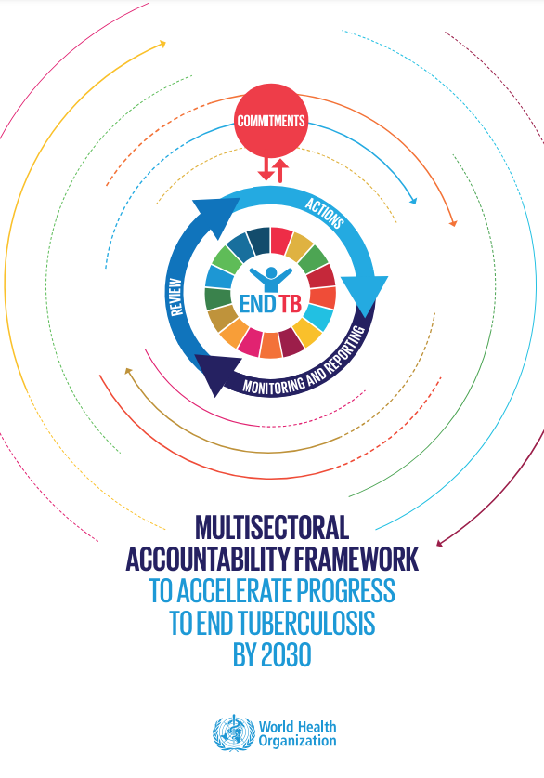
Identifying stakeholders and opportunities for integration
Multisectoral engagement expands the reach of TB care delivery through integration:
Non-health sectors workplaces, schools and correctional facilities
Other health programmes e.g., Maternal, Newborn & Child health, Reproductive health, Adolescent health, Nutrition and Adolescent Girls Young Women (AGYW) programmes
Notes:
TB is often driven by social and economic determinants of health. Therefore, effective and wholistic care for patients with TB cannot be delivered solely by the NTP. It is important for the NTPs to map out stakeholders to engage in the child and adolescent TB response in order to deliver TB care services to those with the greatest need.
The WHO multisectoral accountability framework for TB (MAF-TB) provides guidance on high level engagement for other government programmes for the delivery of TB care services.
Multisectoral engagement expands the reach of TB care delivery through integration into other non-health sectors e.g., workplaces, schools and correctional facilities. Multisectoral engagement may also be implemented within the health sector to improve the reach of TB care delivery through integration with other health programmes e.g., Maternal, Newborn & Child health, Reproductive health, Adolescent health, Nutrition and Adolescents, Girls, Young Women (AGYW) programmes
NTPs should actively reach out to other health and non health programmes to ensure mainstreaming of TB prevention, diagnosis and treatment services into those programme areas.

Slide 25
Multisectoral engagement within health sector–Child and Adolescent TB
Target groups (years) | Health programme
 | PMTCT | EPI | IMCI | iCCM** | Nutrition
Children 0-4 | (For infants and young children exposed to HIV ) TB screening and referral TB Preventive treatment TB Diagnosis and treatment | TB Screening and referral TB Preventive therapy | TB Screening and referral TB Diagnosis and Treatment | TB Screening and referral | TB Screening and referral
Children 5- 9
**iCCM - Integrated community case management.
Notes:
The 2023 roadmap towards ending TB in children and adolescents and the WHO End TB Strategy emphasize the need for integration of TB services into existing care platforms. To achieve this, it is important to integrate TB services into broader child health settings. Integration of TB services into child TB programmes that already have a wide reach e.g. PMTCT, EPI, IMCI, iCCM and nutrition will improve TB case finding among and potentially improve the health outcomes of children enrolled in those programmes.

Slide 26
Multisectoral engagement within the health sector – Adolescent TB
Target groups (years) | Health programme
 | Nutrition | School Health | AYFS** | ANC | PNC
Adolescents 10 -14 | TB Screening and referral | TB Screening and referral | TB screening and referral TB Diagnosis and treatment TB treatment support
Adolescents 15 -19 |  |  |  | TB screening and referral TB Preventive treatment TB Diagnosis and treatment
**AYFS - Adolescent and Youth Friendly Services.
Notes:
Older children and adolescents have unique needs for service delivery including increased confidentiality, youthful/empathetic healthcare workers and short waiting times. These needs are often present in spaces designed to deliver adolescent and youth friendly services. Integrating TB care delivery into those spaces will increase uptake of TB diagnosis and treatment services and improve health outcomes for this group of people. In addition, integrating TB care services into antenatal and postnatal care will help increase TB diagnosis among young mothers.

Slide 27
Conclusion and Summary of key learning points

Slide 28
Summary of key learning points
NTPs lead child and adolescent TB management at facility, district, regional/provincial and national levels.
Integration of TB into other health programmes and services provides an opportunity for sustainability of successful interventions.
Maintenance of quality TB services at all times is critical and requires multisectoral approach.
Notes:
In conclusion, the NTPs lead child and adolescent TB management at facility, district, regional/provincial and national levels.
Integration of TB into other health services is recommended because it provides an opportunity for sustainable successful TB interventions.
Maintenance of quality TB services at all times, even during emergencies, natural disasters, pandemics, etc., is critical and requires multisectoral approach.

Slide 29
References
The Union. Management of tuberculosis: a guide to essential practice. Dlodlo RA, et al. The Union, Paris, France, 2019. https://theunion.org/technical-publications/management-of-tuberculosis-a-guide-to-essential-practice
WHO TB Knowledge Sharing Platform: https://www.tbksp.org -
Open WHO. Management of tuberculosis in children and adolescents – programmatic considerations. World Health Organization, Geneva, 2024 https://openwho.org/courses/TB-child-adolescent-programmatic
WHO operational handbook on tuberculosis. Module 5: management of tuberculosis in children and adolescents. Geneva: World Health Organization; 2022. License: CC BY-NC-SA 3.0 IGO.
Roadmap towards ending TB in children and adolescents, third edition. Geneva: World Health Organization; 2023 https://www.who.int/publications/i/item/9789240084254
WHO. Multisectoral Accountability Framework to Accelerate Progress to End Tuberculosis by 2030. WHO operational handbook on tuberculosis. Module 5: management of tuberculosis in children and adolescents. World Health Organization, Geneva, 2019. 39p.
WHO. Updated WHO Information Note: Ensuring continuity of TB services during the COVID-19 pandemic [Internet]. Geneva: WHO; 2020 [cited May 2024]. Available from: https://www.who.int/news/item/15-12-2020-updated-who-information-note-ensuring-continuity-of-tb-services-during-the-covid-19-pandemic\
CDC. Tuberculosis Information for emergencies and disasters [Internet]. Atlanta: CDC; 2024 [cited May 2024]. Available from: https://www.cdc.gov/tb-programs/php/emergency-disasters/

